Slide 1
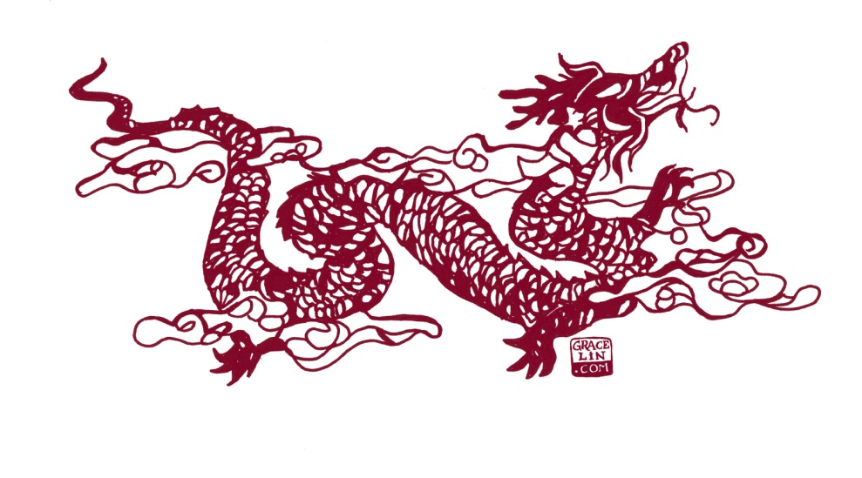
A Tapestry of Tales:
An Exploration of Folktale Motifs in Grace Lin’s
Where the Mountain Meets the Moon

Slide 2
A girl, a legend, a quest, a goal
A novel about storytelling and the importance of story

Slide 3
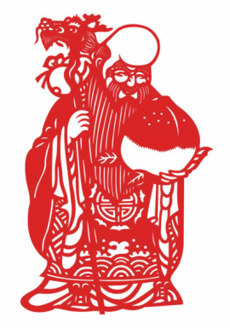
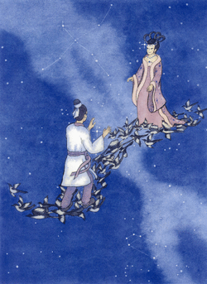
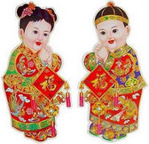
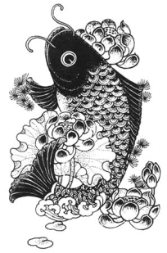
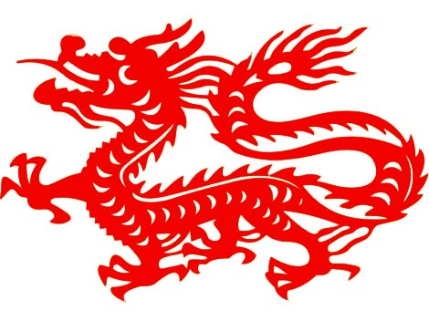
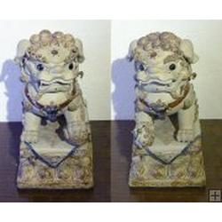
Traditional Chinese Images
Do you recognize any of these?
Do you know the stories behind them?

Slide 4
Stories within the story – set off from text

Slide 6
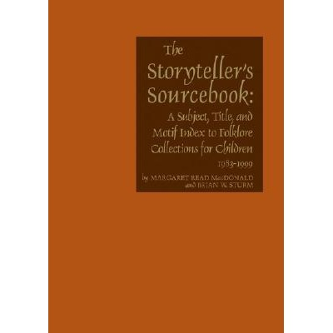
What is a Motif Index?

Slide 7
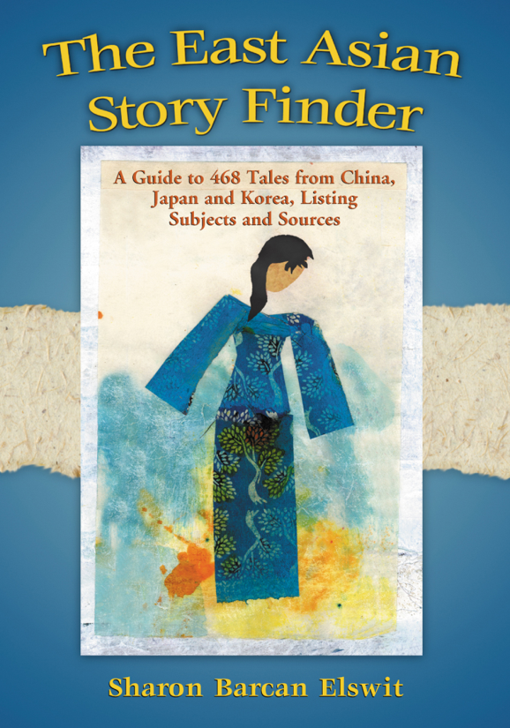
Sources to find Folktale Retellings
Motif Index of Folk Literature by Stith Thompson
Folk and Fairy Tales: A Handbook by D. L. Ashliman
The Storyteller’s Sourcebook: A Subject, Title and Motif Index by Margaret Read MacDonald
World Folklore for Storytellers by Josepha Sherman
The East Asian Story Finder by Sharon Elswit
Other specialized regional or cultural indexes

Slide 8
Frame Story for Novel
“Why must we work so hard yet remain so poor?”
A Question to ask the Old Man of the West/Old Man of the Moon/Wise Old Man of Kunlun Mountain.

Slide 9
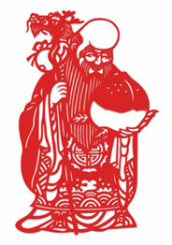
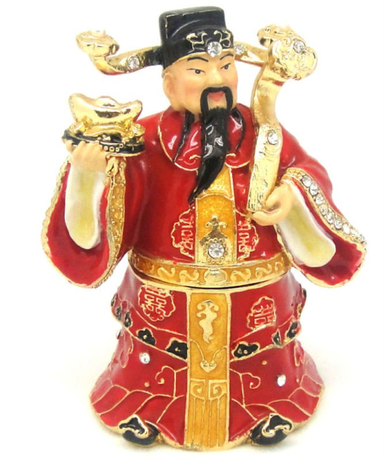
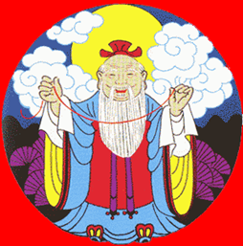
Who is the Old Man of the Moon?
Shou-xing
Yue Lao 月下老人
Cai Shen
財神

Slide 10
Cai Shen, god of wealth
God of wealth, associated with jade and gold.
Known as God of the West.
Notes:
I believe Tsai Shen (Cai Shen) is god/old man usually associated with Olive Lake story. Many versions refer to either Old Man of the West, or Wise Old Man of Kunlun Mountains (in the west). Quest is usually to ask, “why so poor?” Minli says, “When I come back, we will be able to fill our house with gold and jade, (31). Seems reasonable that this question be directed to god of wealth.

Slide 11
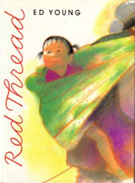
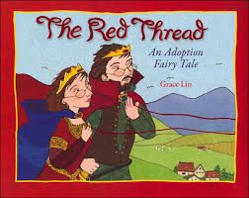
Yue Lao, god of marriage
Yue Lao ties red threads to connect those who will marry-traditional
Yue Lao ties red threads to connect those fated to meet in life; a story about adoption – reinvented story
Notes:
Traditional story about fate, marriage, violent, cannot escape destiny. Grace Lin’s original story, written years before WtMMtM, is kinder, explains that adopted baby and adoptive parents connected at birth by Book of Life. Story as told in WtMMtM blends both.
Story of Old Man of the Moon (p18-24) introduces character of Magistrate Tiger, who takes on role of man in story who tries to avoid marriage fate has decreed for his son. Son/husband is innocent, it is his father who tries to avoid fate. Makes it easier to accept marriage than in Ed Young’s version. How can wife feel reconciled to marriage to man who tried to kill her?
An ancient Chinese belief that an invisible, unbreakable red thread connects all those who are destined to be together. Yue Lao is god pictured with red threads, god of matrimony, one of gods of destiny. Also known as Old Man of the Moon. Literally (Chinese: 月下老人; pinyin: Yuè Xià Lǎorén; "old man under the moon").

Slide 12
Shou Xing, god of longevity
Goldfish seller tells story of changing his fate from death at age 19 to death at 99.
Why can he change his fate, when marriage destined by red threads cannot be avoided? What is different?
Notes:
Familiar figure, large head, carries peach (symbol of immortality). Based on trad story, often told of Shou Xing, about young man who changes destined death, usually changed from 19 to 91. Grace Lin fleshes it out, gives more detail, uses to support her narrative. Fish seller says, “Even fates written in the Book of Fortune can be changed. How can anything be impossible?” (67). Red threads story suggests Fate cannot be changed, but goldfish man is able to change his own fortune. Why is it possible now, but not then? What is different? Kindness, not violence, arrogance. Shou Xing becomes indebted to young man by eating his food (66), but no attempt to COMPEL change of fate.
Shou Xing also known as God of the South Pole. Trad story features two gods, God of the North Pole, who determines birth, and God of the South Pole, who determines death.
Both Yue Lao and Shou Xing have Book of Fortune.

Slide 13
Dragon
Magic helper is traditional element in many folktales.
What question does Dragon have?

Slide 14
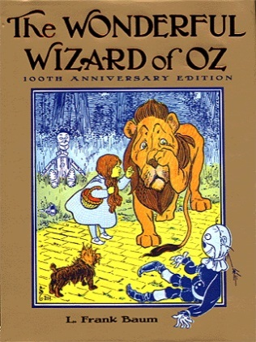
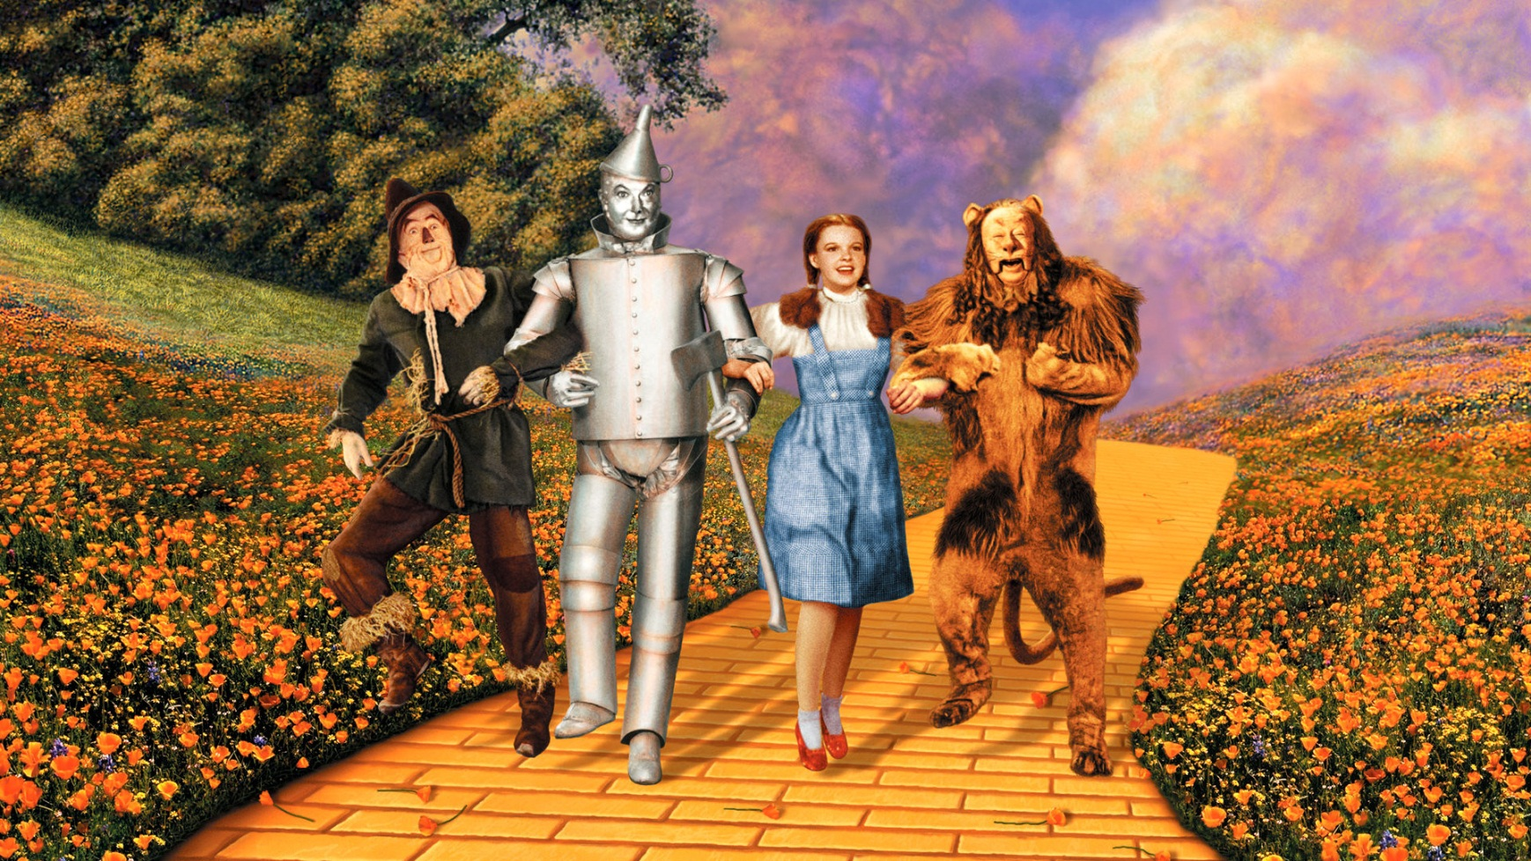
Does this remind you of an American story?
Notes:
Aside: has anyone noticed a resemblance to a familiar American story? Definite parallels to Wizard of Oz. Do you see any connections? Baum used folkloric motifs, including “magic helpers” in writing his original “American fairy tale.” Grace Lin in various interviews acknowledges similarities to WoO, but says, “A lot of people have been calling it a Chinese Wizard of Oz, which is fairly accurate. I love the Wizard of Oz, and I'm actually honored that people think it's kind of a Chinese Wizard of Oz. But as much as I love the Wizard of Oz (I actually have a bit of a Dorothy fixation), I had not thought about the Wizard of Oz when I wrote it.” Grace Lin In-depth Written Interview, teachingbooks.net, May 23, 2011
Grew up in town with only 1 (or 2) Chinese families. "Most of the time, I ignored the fact that racism existed and I spent much of my time trying to forget that I was Asian," the author says. "When someone would point it out to me, it was like a slap in the face." She recalls such a time in the book “Year of the Dog,” when she was excited to try out for the part of Dorothy in her school's production of The Wizard of Oz. Just before the audition, one of her girlfriends told her, "You can't be Dorothy. Dorothy's not Chinese." "Suddenly the world went silent," Lin writes, "Like a melting icicle, my dream of being Dorothy fell and shattered on the ground.” Grace Lin: Sharing Asian traditions with young readers” BookPage® Interview by Heidi Henneman, February 2006. http://bookpage.com/interviews/8337-grace-lin#.U361jvRDvjw
Several references to Minli’s homesickness call to mind Dorothy – “I want to go home.”

Slide 15
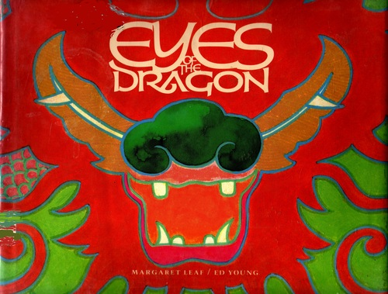
The Dragon’s Story
Not like other dragons
Can’t fly
No name
Created by artist; came to life
Notes:
Dragon’s story: Not like other dragons. Doesn’t have name. All it remembers is coming alive from a painting. Artist painted all but dragon’s eyes, when eyes painted in, came to life. (D435.2.1) Motif also found in tales from other cultures, often found in Asian stories. Story also known as “The Magic Brush.”
Why can’t dragon fly? As artist in WtMMtM explains, he is making painting for Magistrate Tiger, “I have painted this dragon on the ground, not flying in the sky like all other dragons” (52)”. Deliberately doesn’t paint eyes. After eyes added, at Magistrate Tiger’s residence, Dragon comes alive and destroys his residence. When Minli and Dragon come to City of Bright Moonlight, they are warned, “the last dragon sighted was a hundred years ago and it destroyed the king’s father’s palace in a city in the East. They might not take too kindly to you” (95). Links actual dragon and actual city to story of long ago.
Artist also explains that he uses special inkstone to paint, later realize this is inkstone made from stone taken from Fruitless Mountain. Connects narrative, Minli and Dragon’s quest, to Magistrate Tiger’s story, and to trad story of Magic Paintbrush/Dragon’s Eyes. When Dragon finally arrives at Fruitless Mountain, feels that he must remain, leaves Minli to go home on her own (264). Doesn’t know why, but he feels the bond. “Strangely, I feel like I am home.” Once he is there, Fruitless Mountain becomes Fruitful Mountain.

Slide 16
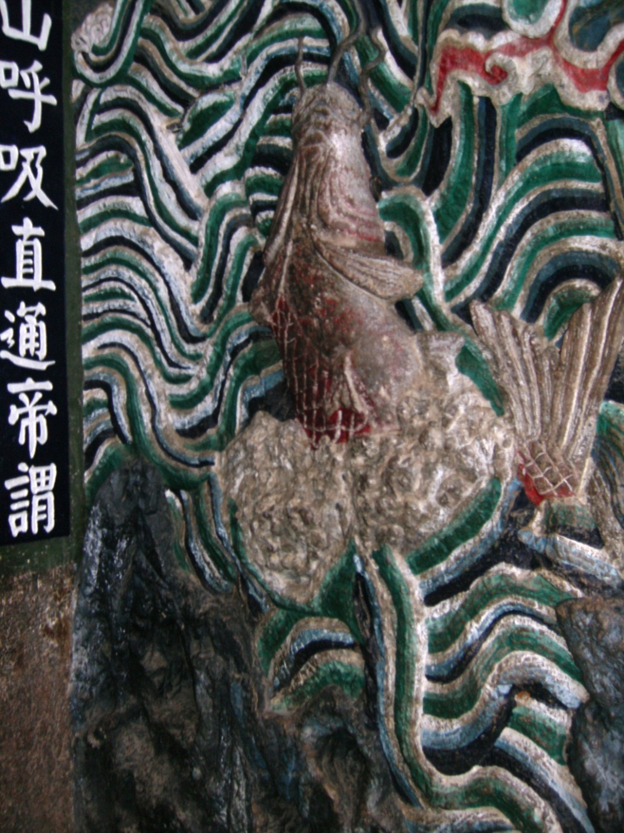
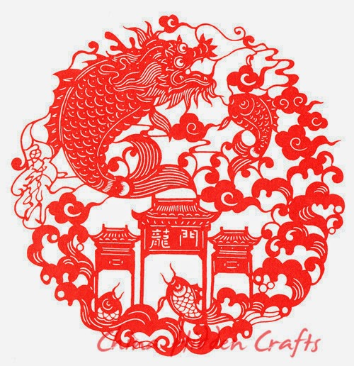
What About the Goldfish?

Slide 17
Where is Never-Ending Mountain? Where is Fruitless Mountain? (very approximate guess) Pure speculation!!!!
Just for Fun – Pure Speculation. . . .

Slide 18
The Double-Seven Festival
The Legend of the Weaver Girl and the Cow Herd

Slide 19
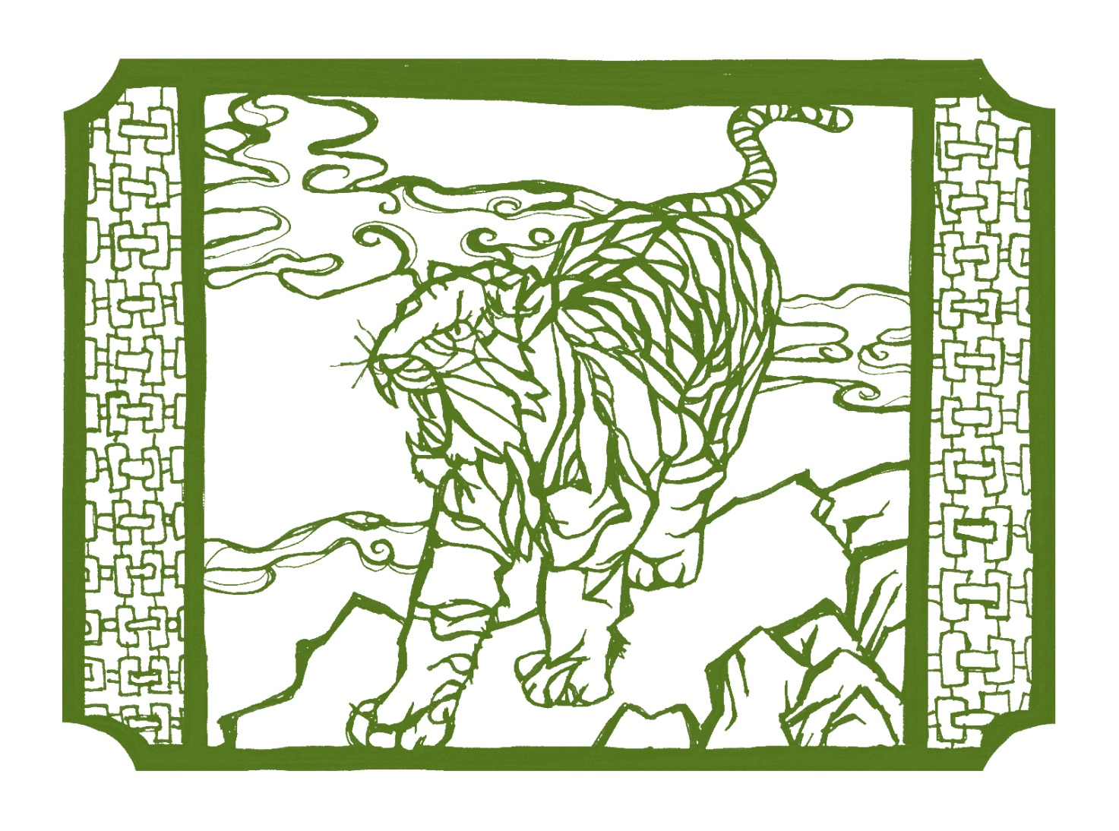
The Green Tiger
The Evil Magistrate/The Tiger Magistrate

Slide 20
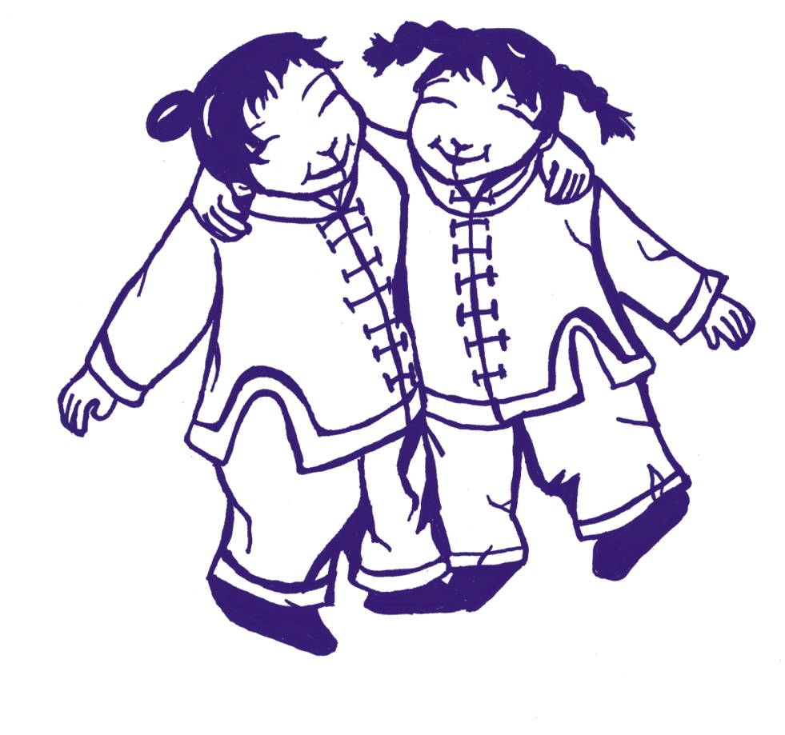
The Happy Family and the Lost Paper of Happiness
What one word do you think is secret to happiness?
仁慈 Réncí "kindness"
满意 Mǎn yì "contentment"
感恩 Gǎn'ēn "thankfulness"

Slide 21
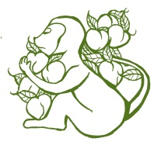
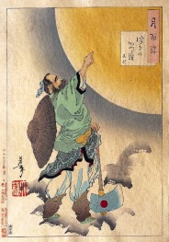
Many other stories
The Greedy Monkeys
The Magic Peach (or Pear) Tree
Wu Kang Chopping the Tree on the Moon
Did you recognize any other familiar stories?

Slide 22
A Tapestry of Tales: Folklore Motifs in Grace Lin’s Where the Mountain Meets the Moon Works Consulted for presentation
Kuo, Louise and Yuan His Kuo. Chinese Folktales. Celestial Arts, 1976. 398.2 Ch
Leaf, Margaret. Eyes of the Dragon. E Leaf
Legends of Ten Chinese Traditional Festivals. Dolphin Books, 2002. J 394.26951 Le
MacDonald, Margaret Read. The Storytellers Sourcebook: A Subject, Title, and Motif Index to Folklore Collections for Children. [1961-1981]. Gale, 1982.
MacDonald, Margaret Read. Three-Minute Tales. J 398.2 MacDonald
MacDonald, Margaret Read and Brian Sturm. The Storytellers Sourcebook: A Subject, Title, and Motif Index to Folklore Collections for Children, 1983-1999. 2d ed. Gale, 2001.
Roberts, Moss. Chinese Fairy Tales and Fantasies. Pantheon, 1979. 398.2 Chinese
Sims, Lesley. The Dragon and the Phoenix. (Usborne First Reading). Usborne, 2007. E S
Tang, Sanmu. Celebrating Chinese Festivals: A Collection of Holiday Tales, Poems and Activities. Better Link Press, 2012. J 394.26951 Ta
Wang, Rosalind. The Fourth Question: a Chinese Tale. Holiday House, 1991. J 398.2 W
Werner, Edward T. C. Ancient Tales and Folklore of China. Bracken Books, 1986. 299.51 We
Wu, Luxing. 100 Chinese Gods. AsiaPac, 1994. R 299.51 Wu
Yip, Mingmei. Chinese Children’s Favorite Stories, v. 1. J398.20951 Ye
Young Ed. The Red Thread. J 398.2 Young
Yuan, Haiwang. The Magic Lotus Lantern and other Tales from the Han Chinese. J 398.20951 Yuan
Internet Sources:
Encyclopedia Mythica. http://www.pantheon.org/areas/mythology/asia/chinese/articles.html
GODchecker: Your Guide to the Gods. http://www.godchecker.com/
Law, Stephanie Pui-Mun. http://www.shadowscapes.com/image.php?lineid=4&bid=838
Werner, Edward T. C. Myths and Legends of China. Harrap, 1922. http://www.gutenberg.org/files/15250/15250-h/15250-h.htm#d0e1663
Wikipedia. http://en.wikipedia.org/ several entries.

Slide 23
谢谢
Thank you!
Li Zhen Zhao, Hawaii State Library, Social Sciences & Philosophy
Kathy Tam, Hawaii State Library, Social Sciences & Philosophy
Tisha Aragaki and staff of Hawaii State Library, Edna Allyn Room for Children
Grace Lin, for writing Where the Mountain Meets the Moon
CLH, for providing forum discussion of children’s literature

